Slide 1
Introduction to Data Engineering

Slide 2
Agenda
What is Data?
Why Data is Important?
What is Data Engineering?
Data Engineering Lifecycle
Different Roles & Titles in Data Engineering
ETL (Extract, Transform, Load) Process
Types of Data
Storage in Data Engineering
Uber Use Case
Tools & Technologies
Course Modules

Slide 3

What is Data?
Data is a collection of facts, information, and statistics and this can be in various forms such as numbers, text, sound, images, or any other format.

Slide 4






What could be the data these companies have?
Facebook
Netflix
Spotify
Noon
Banks
Vodafone
Any seller company

Slide 5
Company | Types of Data Collected
Facebook (Meta) | User profiles, posts, likes, friends, ads, time spent.
Netflix | Watch history, preferences, device used, search history, ratings.
Spotify | Songs played, playlists, skips, search history, ads, subscriptions.
Noon (E-commerce) | Browsing & purchase history, cart activity, payment, reviews.
Banks | Transactions, loans, card usage, fraud detection, customer support.
Seller Companies | Sales, customer details, payment trends, inventory.
Vodafone & Telecom | Calls, SMS, internet usage, location, billing, customer support.

Slide 6

Data is the new oil

Slide 7
Why Data is Important?
1) Decision-making
2) Problem solving
3) Understanding
4) Improving processes
5) Understanding customers

Slide 8
What is Data Engineering?
Data engineering is the practice of designing and building systems for the aggregation, storage and analysis of data at scale. Data engineers empower organizations to get insights in real time from large datasets.

Slide 9
Before AI and Data Science Magic
First you need Data Engineering

Slide 10
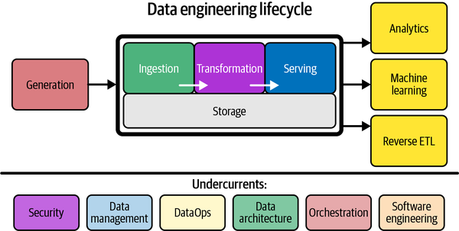
Data Engineering Lifecycle

Slide 11
What Does a Data Engineer Do?
Design & Build Data Pipelines
Collect, transform, and move data efficiently.
Develop & Manage Databases
Store structured & unstructured data for easy access.
Ensure Data Quality & Integrity
Validate data accuracy, consistency, and reliability.
Collaborate with Teams
Work with data scientists, and analysts.
Optimize Data Workflows
Automate processes and improve efficiency.

Slide 12
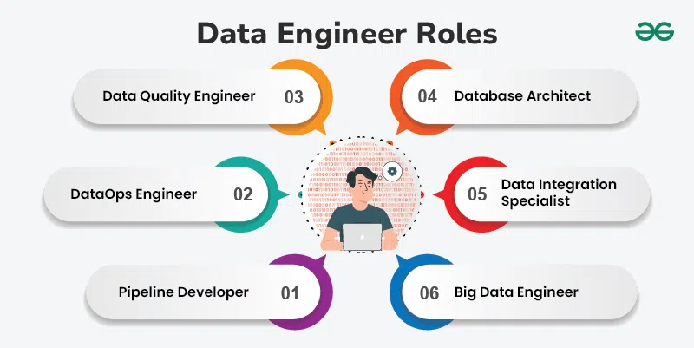
Different Roles

Slide 13
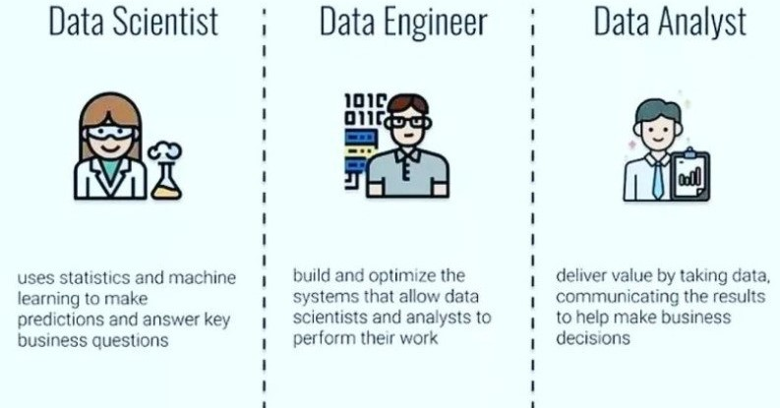
Different Titles

Slide 14
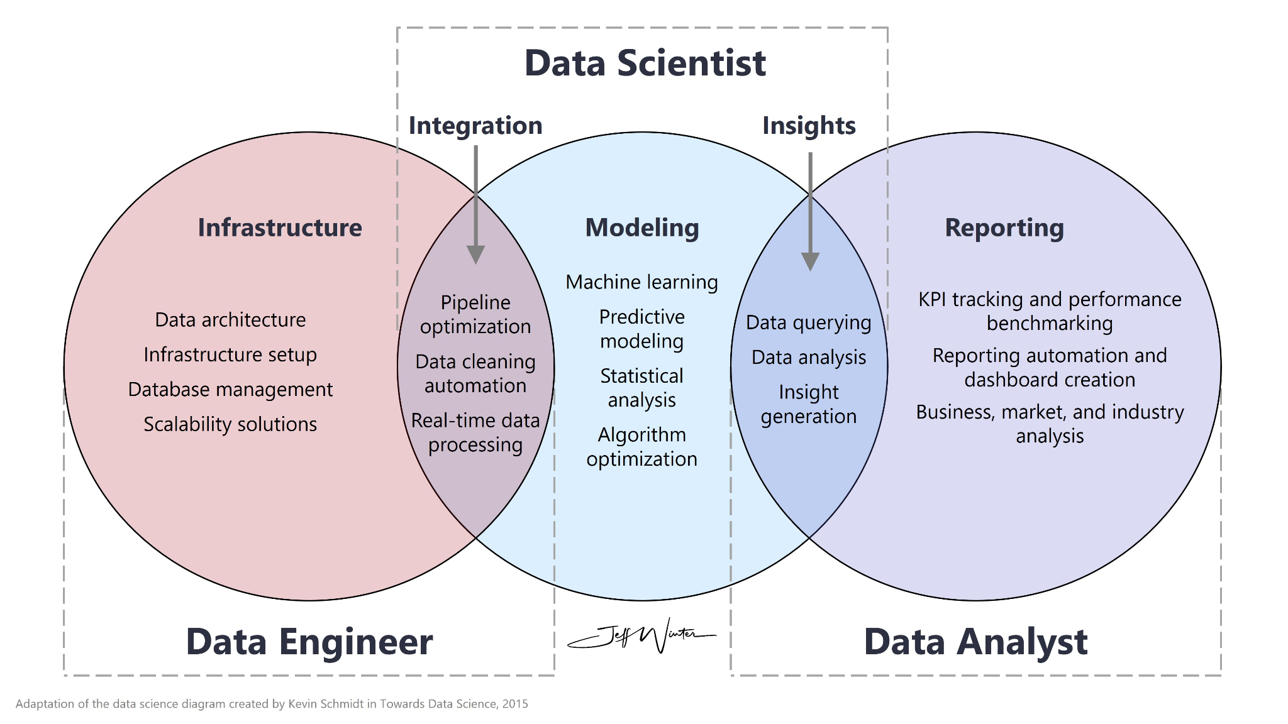

Slide 15
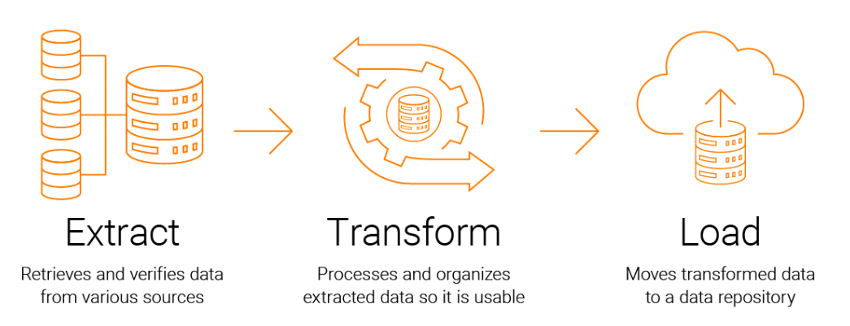
Data Engineer Closer Job: ETL
ETL stands for extract, transform, and load and is a traditionally accepted way for organizations to combine data from multiple systems into a single database, data store, data warehouse, or data lake.
Notes:
V
ETL is an important way to bring all relevant data together in one place to make it actionable—to analyze it and enable executives, managers, and other stakeholders to make informed business decisions based on it.
ETL is an important way to bring all relevant data together in one place to make it actionable—to analyze it and enable executives, managers, and other stakeholders to make informed business decisions based on it.

Slide 16
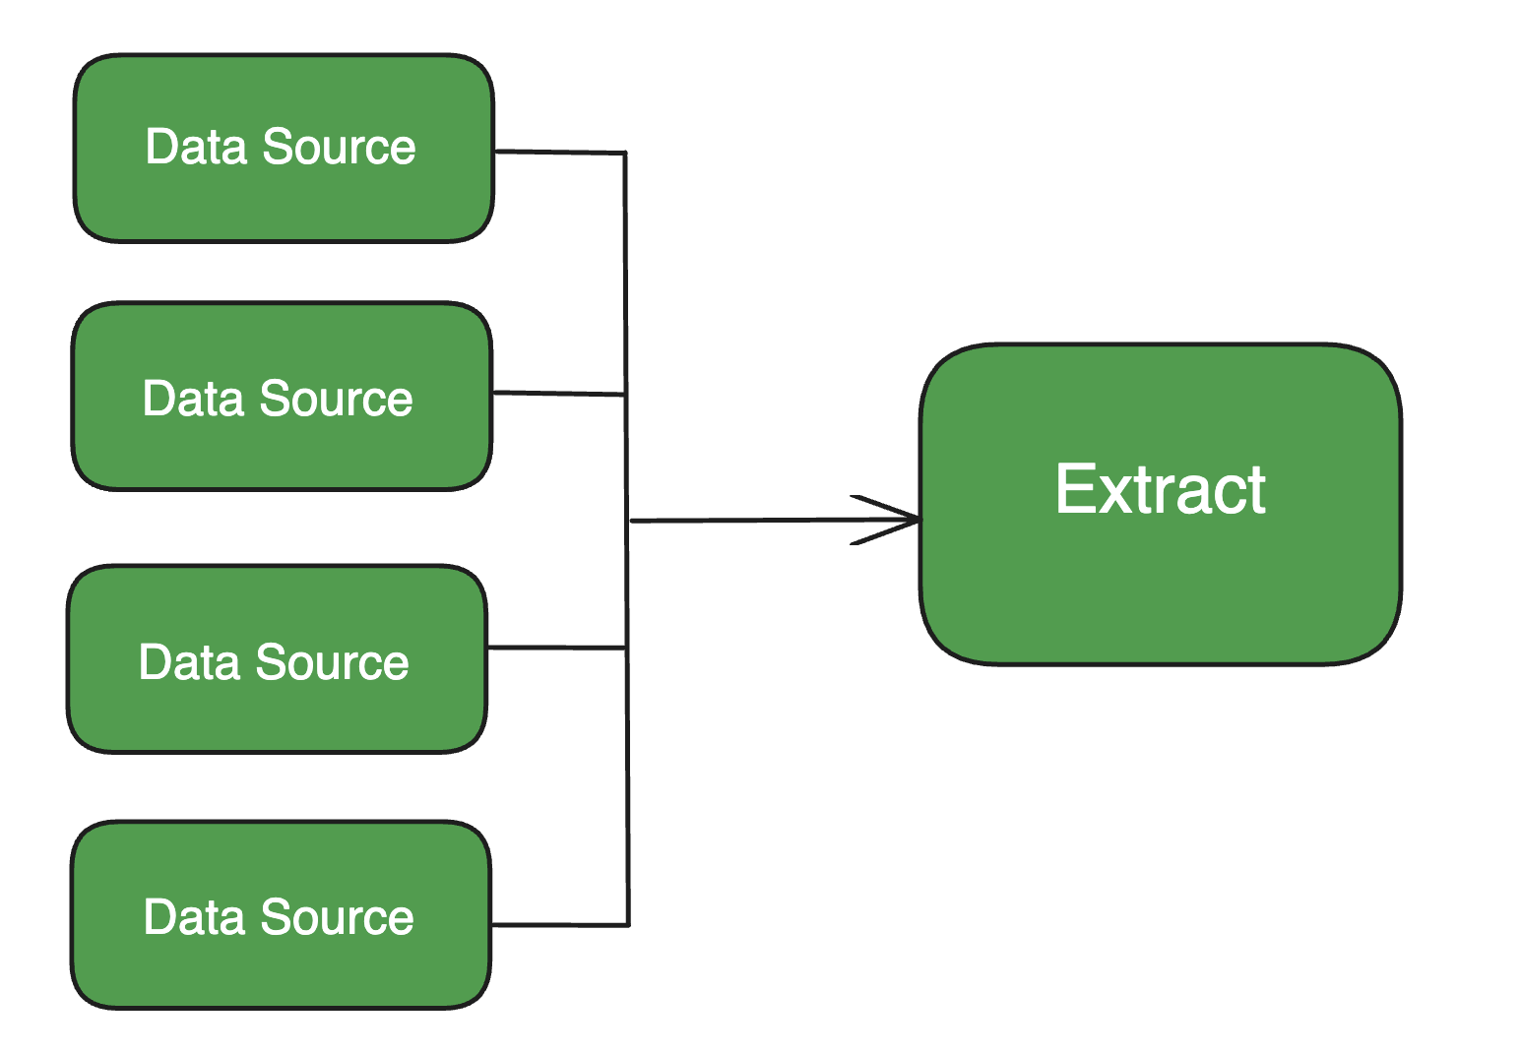
ETL: Extract
Extraction is the process of retrieving data from one or more sources—online, on-premises, legacy, SaaS, or others. After the retrieval, or extraction, is complete, the data is loaded into a staging area.

Slide 17
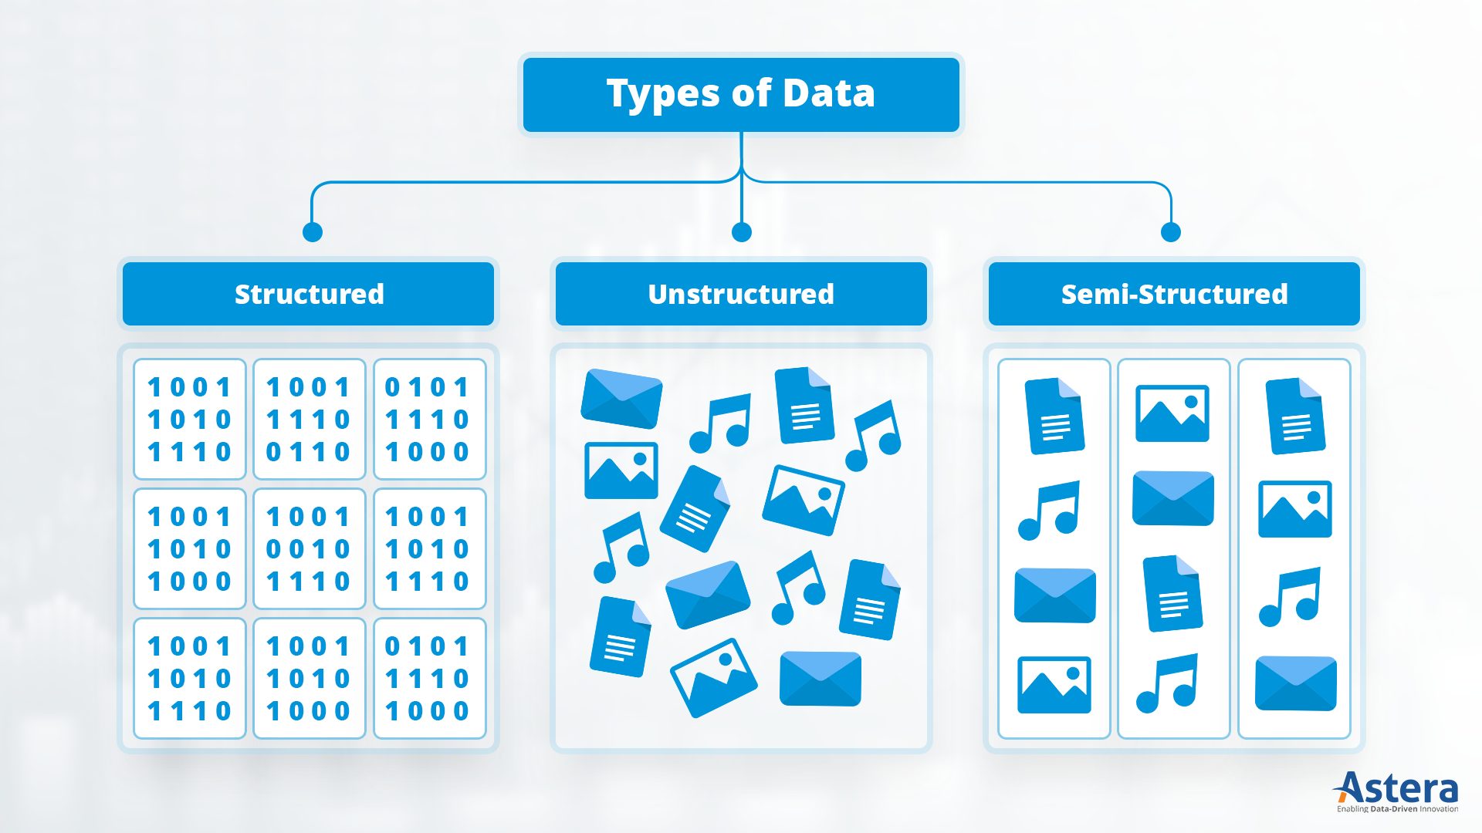
Data Sources have Several Forms

Slide 18
What is structured data?
Structured data is organized in a clear, predefined format. The standardized nature of structured data makes it easily decipherable by data analytics tools, machine learning algorithms and human users.
Structured data can include both quantitative data (such as prices or revenue figures) and qualitative data (such as dates, names, addresses and credit card numbers).
For example, a financial report with company names, expense values and reporting periods organized into rows and columns is considered structured data.

Slide 19
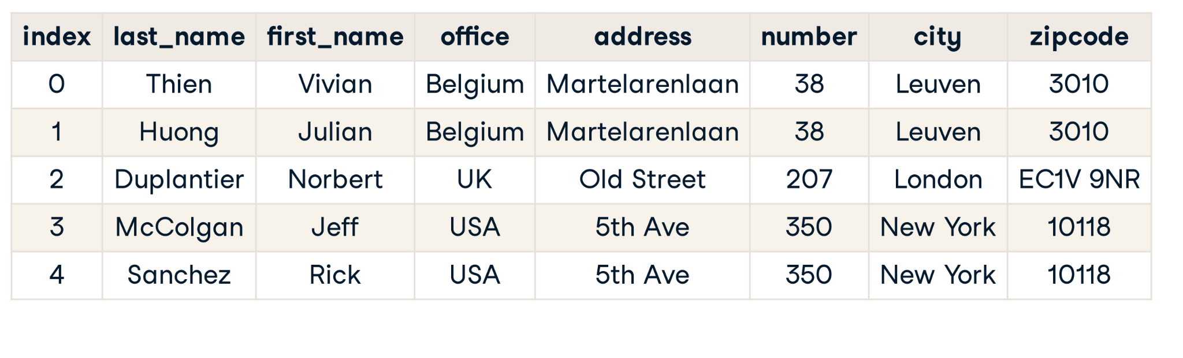
Example of Structured Data

Slide 20
What is unstructured data?
Unstructured data does not have a predefined format.
Unstructured data can contain both textual and non-textual data and both qualitative (social media comments) and quantitative (figures embedded in text) data.
Examples of unstructured data from textual data sources include, Emails, Text documents, Social media posts, Call transcripts, Message text files, such as those from Microsoft Teams or Slack
Examples of non-textual unstructured data include, Image files (JPEG, GIF and PNG), Multimedia files, Video files, Mobile activity, Sensor data from (IoT) devices

Slide 21



Example

Slide 22
What is semi-structured data?
Semi-structured data has a loose structure but not a rigid schema like structured data.
Semi-structured data contains tags or markers to separate data elements but does not conform to a strict table format as in relational databases.
Examples of semi-structured data from textual data sources include:
* JSON (JavaScript Object Notation) files
* XML (eXtensible Markup Language) documents
* YAML files
* NoSQL databases (e.g., MongoDB, Couchbase)
* Email metadata (sender, recipient, timestamp, subject)
Examples of semi-structured data from non-textual sources include:
* Log files from web servers or applications
* Sensor logs with labeled fields (e.g., temperature: 22.5, humidity: 70%)
* Configuration files
* Streaming data with nested structures (e.g., telemetry data)
* Tagged image or video metadata (EXIF data)

Slide 23
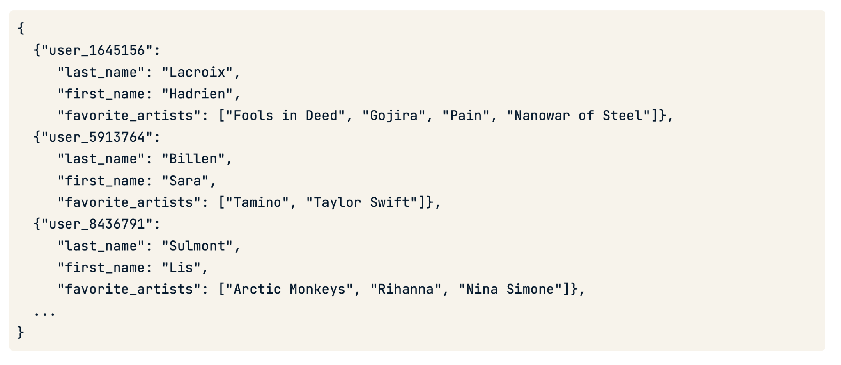
Semi-structured Example

Slide 24
ETL: Transformation
Transformation involves taking that data, cleaning it, and putting it into a common format, so it can be stored in a targeted database, data store, data warehouse, or data lake. Cleaning typically involves taking out duplicate, incomplete, or obviously erroneous records.

Slide 25
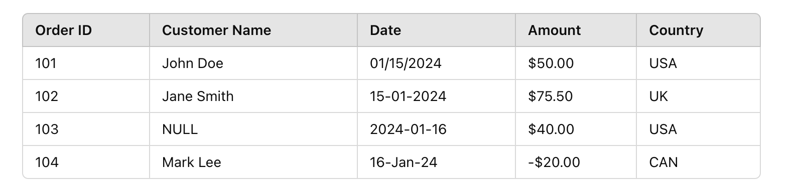
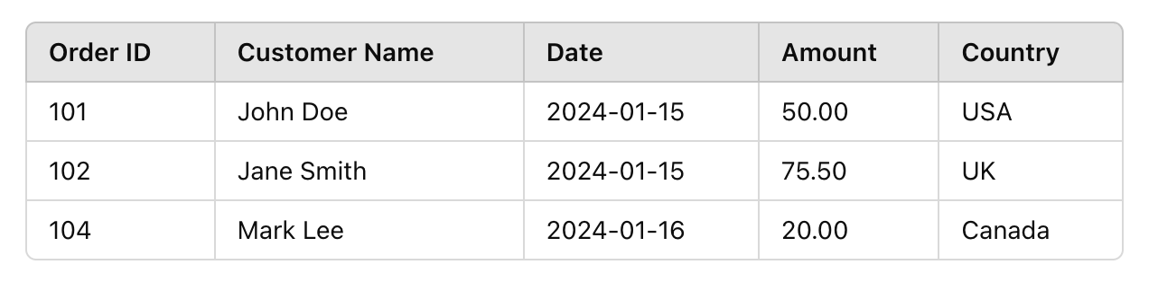
Example: Raw Data (Before Transformation) Vs. After

Slide 26
Transformation Steps Taken:
Convert date formats to a standard format (YYYY-MM-DD)
Remove duplicates and NULL values
Convert negative amounts to absolute values (if applicable)
Standardize country names

Slide 27
ETL: Load
Loading is the process of inserting that formatted data into the target database, data store, data warehouse, or data lake.
Scenario
A company collects daily sales data from multiple branches. After extracting the data and transforming it (cleaning, formatting), it needs to be loaded into a centralized “database” for reporting.

Slide 28
Back to the lifecycle: Storage

Slide 29
Storage
Storage is the cornerstone of the data engineering lifecycle and underlies its major stages—ingestion, transformation, and serving. Data gets stored many times as it moves through the lifecycle. To paraphrase an old saying, it’s storage all the way down.

Slide 30
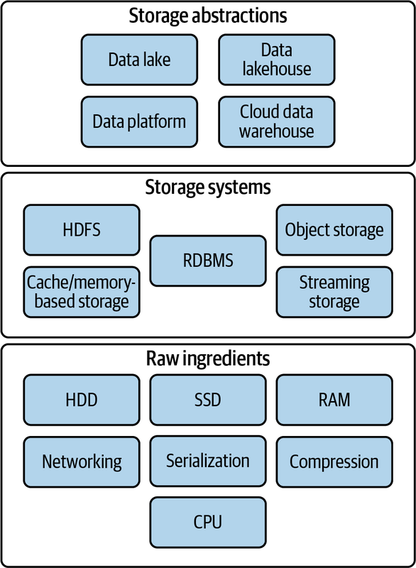
Storage Components

Slide 31
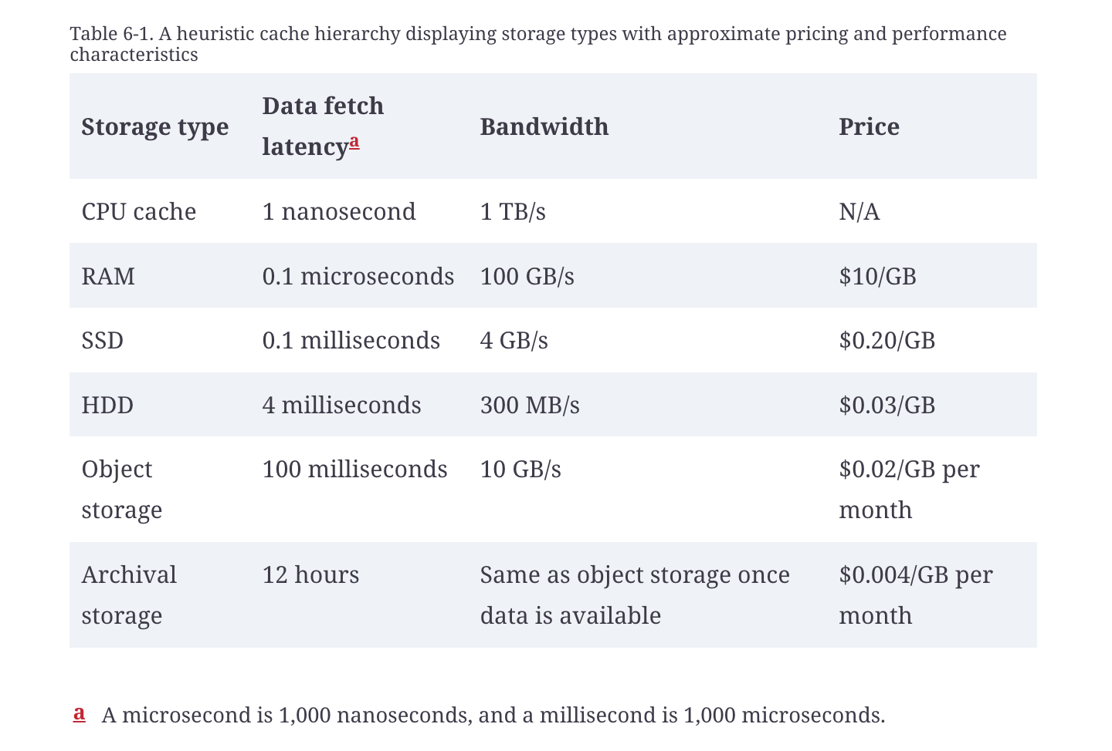
Different Types of Storage

Slide 32
Data Engineering Storage Abstractions
Data warehouses
Data lakes
Data lakehouses

Slide 33
Comparison
Feature | Data Warehouse | Data Lake | Data Lakehouse
Data Types | Structured data only | Structured, semi-structured, unstructured | Structured, semi-structured, unstructured
Storage Cost | High (optimized for structured data) | Low (scalable for large volumes) | Moderate (balances cost & performance)
Performance | Fast for structured queries | Slower without optimization | Optimized for both structured & unstructured data

Slide 34

Uber use-case

Slide 35
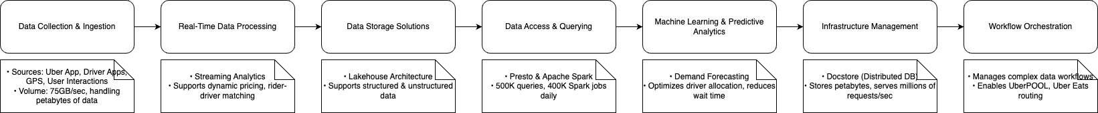
Uber Abstracted Data Pipeline Flow

Slide 36
Technology & Tools Used in the Course
Programming: Python
Cloud: Microsoft Azure
Storage Tools: MySQL/PostgreSQL
Querying: SQL
Processing: Apache Spark, Hadoop.
Orchestration: Apache Airflow

Slide 37
Course Modules Overview
Module | Topic
Module 1 | Introduction to Data Engineering
Module 2 | Programming Essentials
Module 3 | SQL & Database Management
Module 4 | Advanced Python for Data Engineering
Module 5 | Data Pipelines
Module 6 | Big Data Processing
Module 7 | Microsoft Azure Data Engineer
Module 8 | Deployment
Module 9 | AI for Data Engineers
Module 10 | Capstone Project

Slide 38
Thank you

